Slide 1
JS Overview
Single Page Application with Angular
Brygar Ivan & Romanov Alexander
Developer and QA in Sustained Engineering Team
ivb@sitecore.net / arr@sitecore.net October 2014

Slide 2
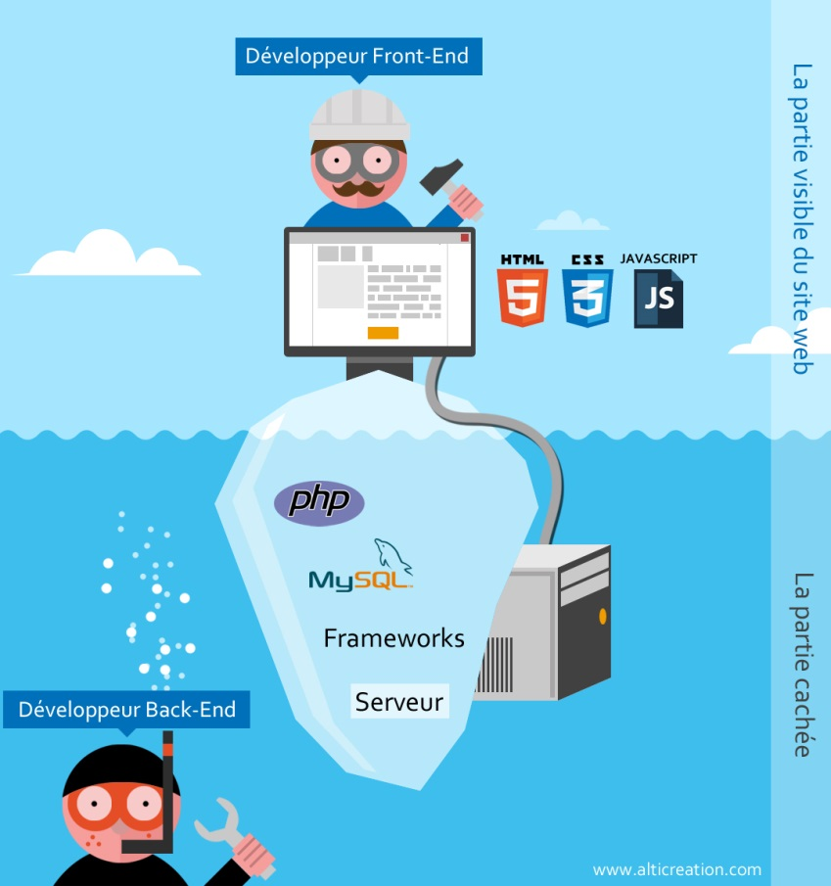
Where is going JS?
Logic in front-end (obviously), but quite complicated then before.
Back-end like a CRUD

Slide 3
Evolution of JS
Few words about OOP
JS don’t have concept of class, but have objects.
Programming with functions and objects (example: C# - programming with classes and objects)
ES 6 is coming…
new keywords: class, public, private, import (similar to using, works even through http).
Not stable yet, some keywords changing.
Tool ES 6 => ES 5

Slide 4




Evolution of JS
jQuery – fresh breath for developers (encapsulated all difficulties of JS, cross-browser).
JS Frameworks – architecture basement (Knockout, Backbone, AngularJS, etc).

Slide 5
SPA – Single Page Application (NOT DONE YET)
Frameworks helps create SPA application.
Example of SPA.
…

Slide 6

JS and SEO (NOT DONE YET)
Minification
Uglification
…tools example

Slide 7


JS in back-end (NOT DONE YET)
Few words about Node.js

Slide 8

JS scaffolding (NOT DONE YET)
yeoman

Slide 9

JS automation (NOT DONE YET)
Few words about Grunt

Slide 10


Plan for demo
Build SPA (Single Page Application) step by step
Create tests for SPA using protractor

